Slide 1


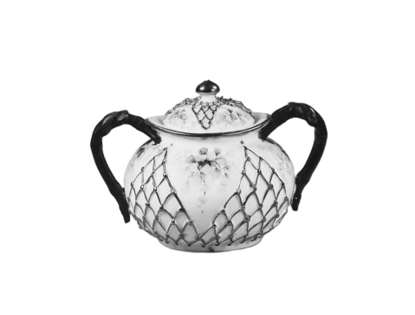



Sugarbowl CGM Analyzer
JEN BALASI
LA MONTE YARROLL
Notes:
LeMonte

Slide 2
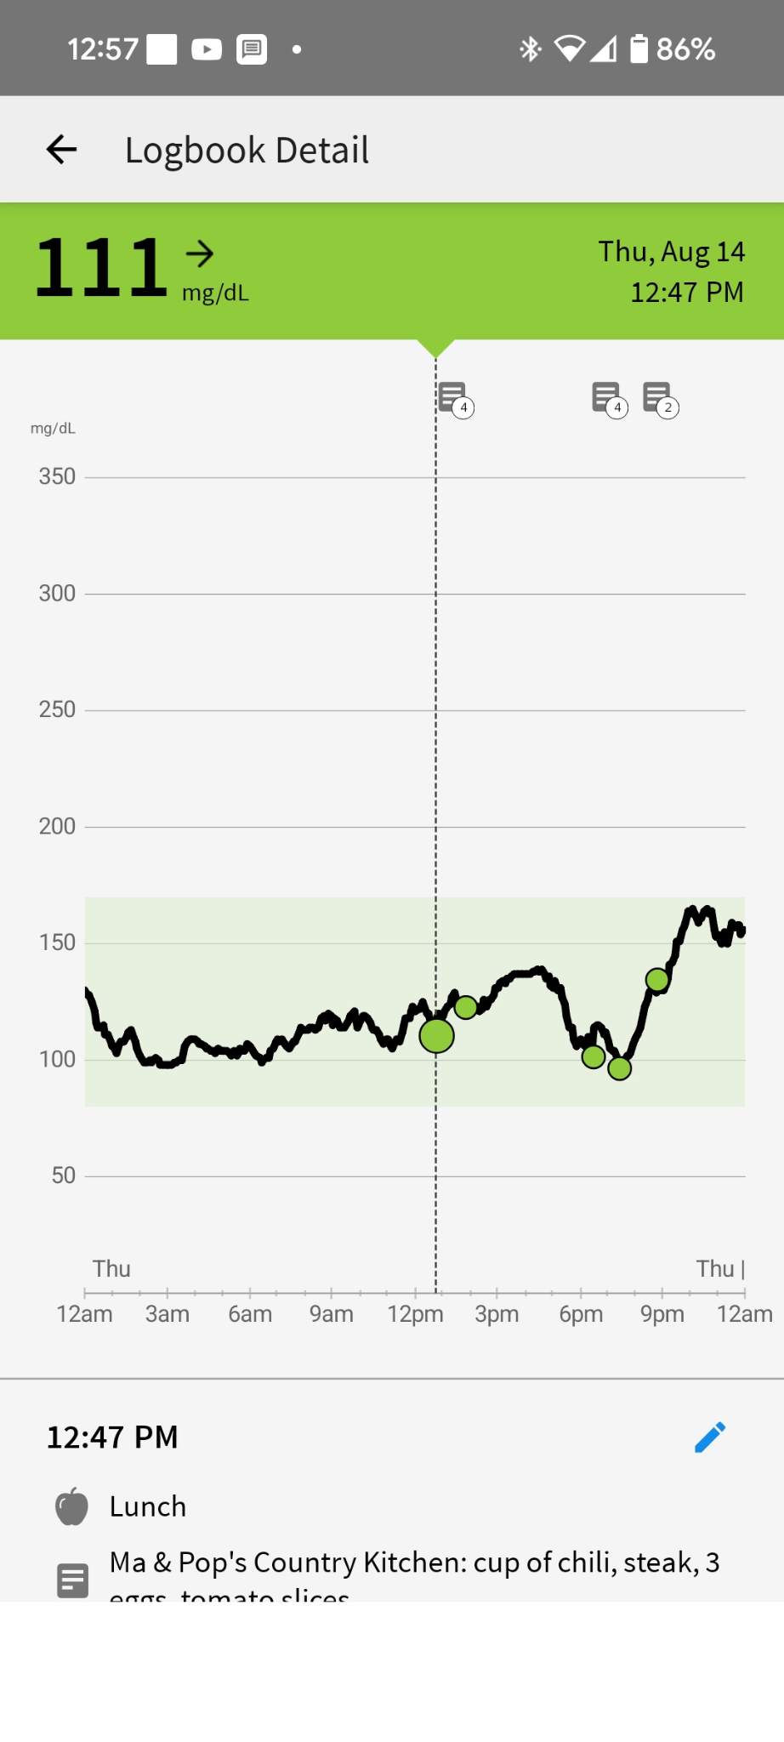
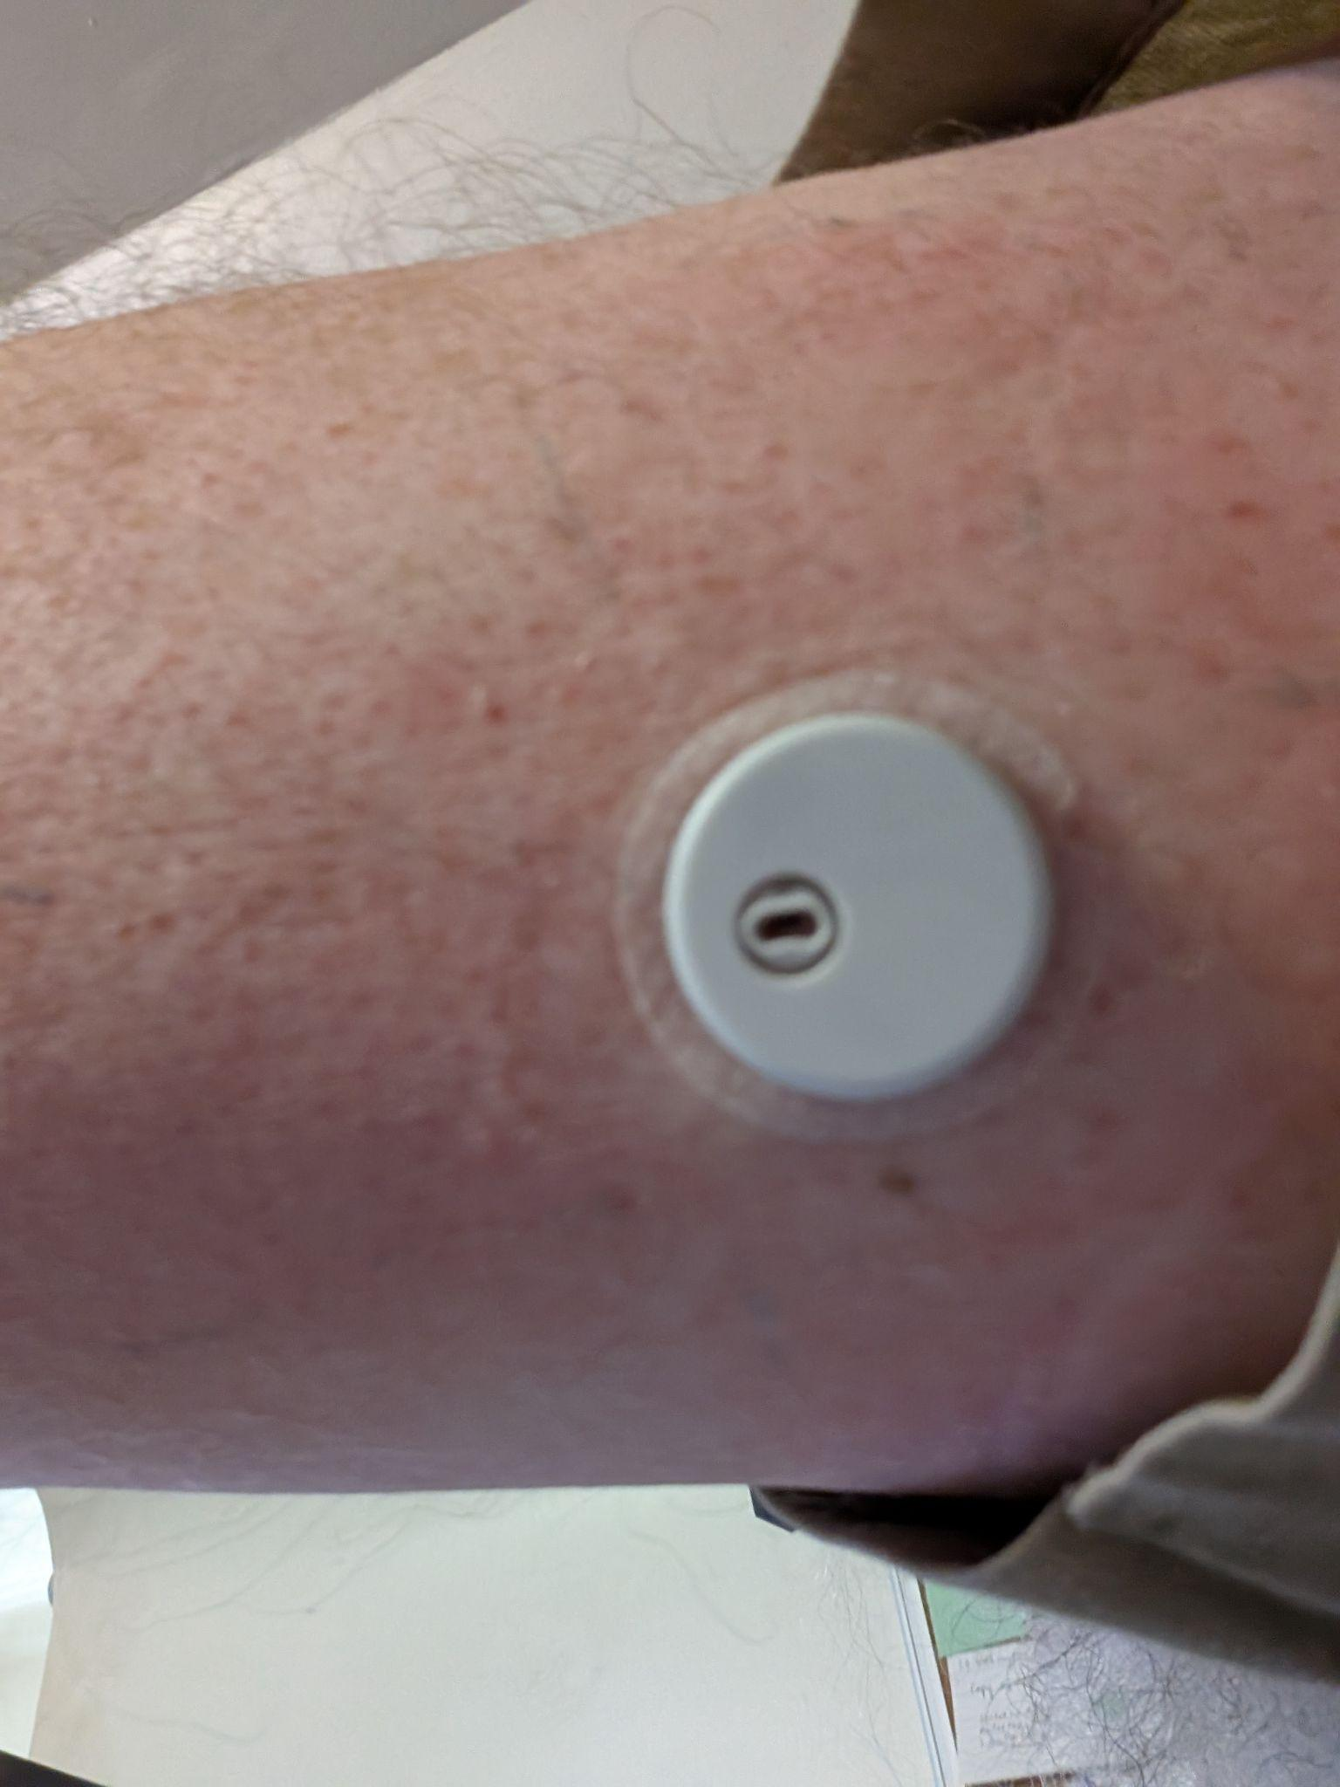
What is a Continuous Glucose Monitor?

Slide 3
Project Vision
Problem statement
Which of my foods are the most costly?
For each log entry calculate glycemic increment (G+)
Tokenize meal entries
Perform regression:
Vocabulary predicts glycemic increment
Which foods are most costly?
Tokenization research
unigrams
bigram & trigrams
Comma-separated fields
Restaurant as a separate feature
Units (servings, bowls, spoonfuls)
Multipliers (n servings of…)

Slide 4
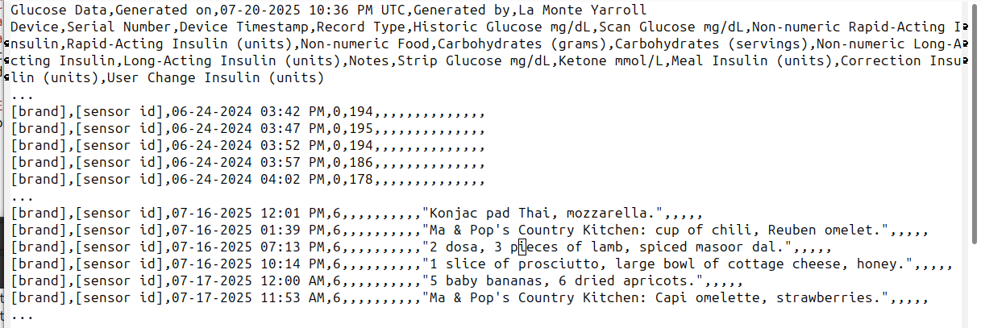
Dataset
Our dataset is a near-continuous record of glucose levels every 5 minutes for 2 years, along with free-form text descriptions of most of the meals.

Slide 5
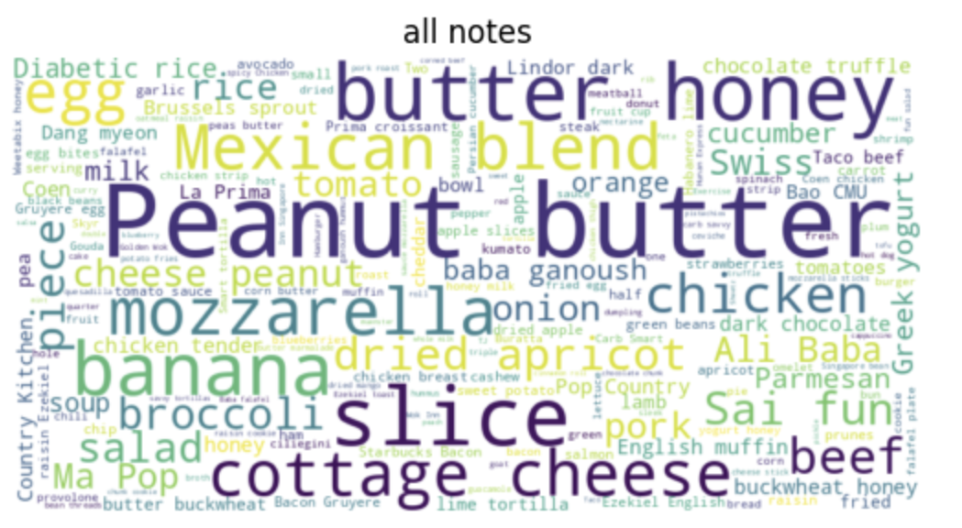
Initial Exploration EDA

Slide 6
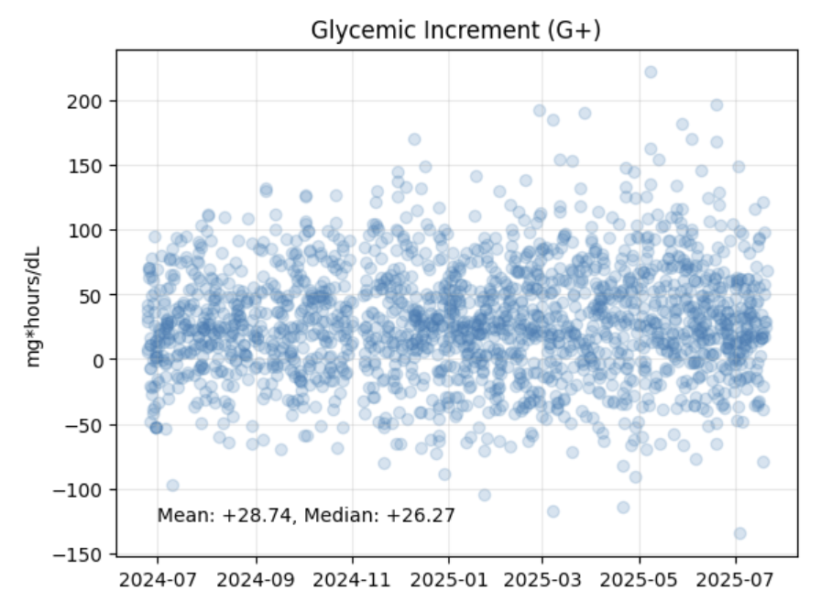
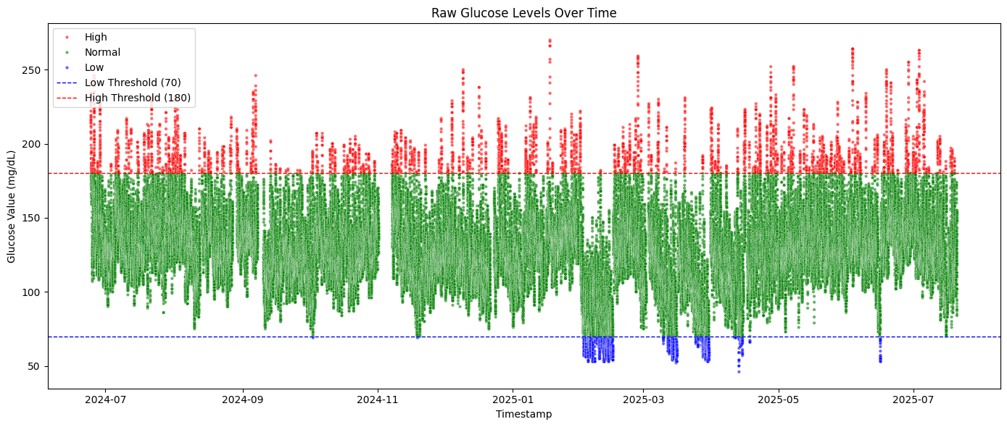
Initial Exploration
Initial Statistics
  Total Records: 124907
  Total Readings: 119484
  Total meals: 1874
  Meals with sufficient data to calculate G+: 1848

Slide 7
Standard Glycemic Measures
Glycemic Index (GI) is a measure of how quickly 50g of carbohydrates from a particular food are absorbed over 2 hours, normalized against 50g of pure glucose.
Glycemic Load (GL) is a measure of how quickly a typical serving of a particular food will affect glucose levels over the next 2 hours. It is GI * carbs in a serving / 100.

Slide 8
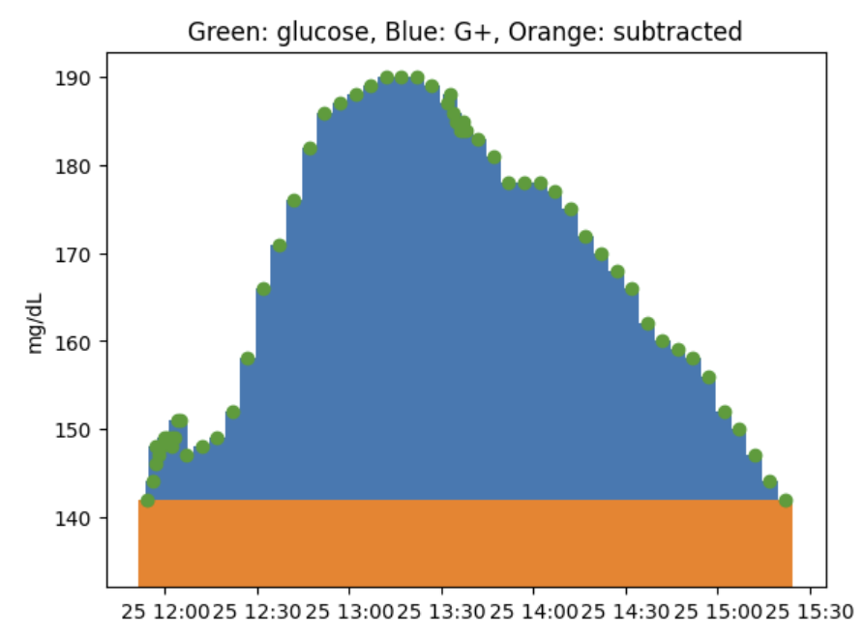
Glycemic Increment
Glycemic Increment (G+) is new for our study. It’s the area under the glucose curve for 2 hours from eating, minus the starting glucose. The unit is mg-hours/dL.

Slide 9
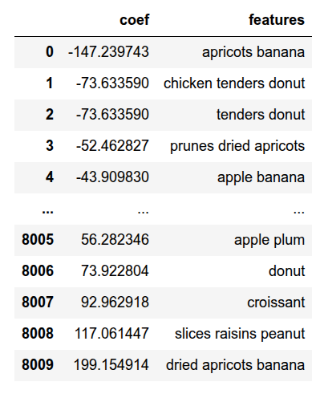
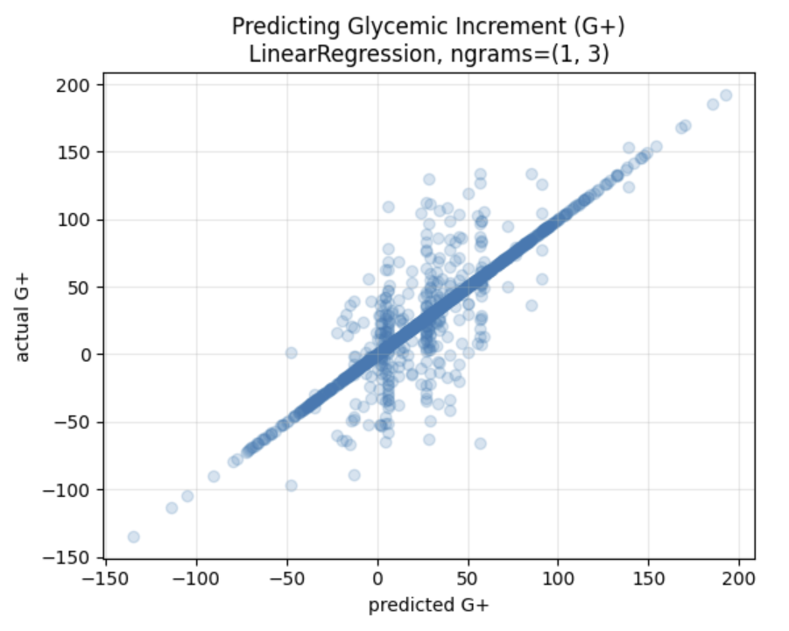
Initial Exploration First model

Slide 10
Path Forward
More models
SVR in addition to LinearRegression (rmse to evaluate best model)
Tune the G+ metric–deal with negative values
  Ignore
  Make meal groups
Increasing levels of structure from the text:
  unigram, bigram, trigram
  choose appropriate stop words
  split on commas
  pull out restaurants separately
  decode units and quantities

Slide 11

Questions?

Slide 12
ADA Target Levels for Blood Glucose
Notes:
This is all of the data points over time showing in what range the reading fell. Less than 70 is considered low, higher than 180 is considered too high. We need to keep the glucose levels in the green.

Slide 13
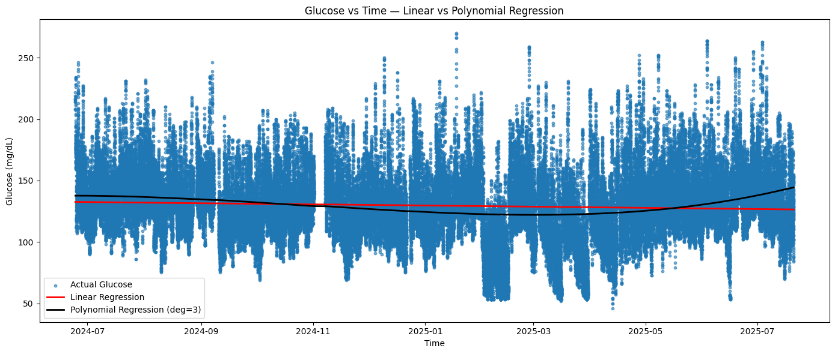
Glucose over time regressed
Notes:
This is all of the data points over time showing in what range the reading fell. Less than 70 is considered low, higher than 180 is considered too high. We need to keep the glucose levels in the green.

